Slide 1
LINEAR POWER SUPPLY COMPONENTS & DATA SHEETS

Slide 2
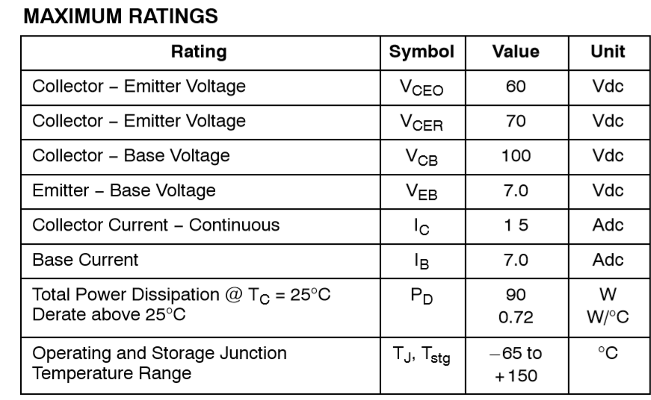
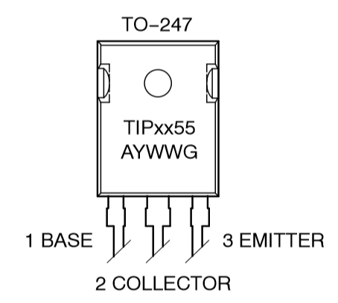
Tip3055G NPN power transistor
Features
• DC Current Gain − hFE = 20− 70 @ IC = 4.0 Adc
• Collector−Emitter Saturation Voltage − VCE(sat) = 1.1 Vdc (Max) @ IC = 4.0 Adc
15 AMPERE POWER TRANSISTORS COMPLEMENTARY SILICON 60 VOLTS 90 WATTS

Slide 3
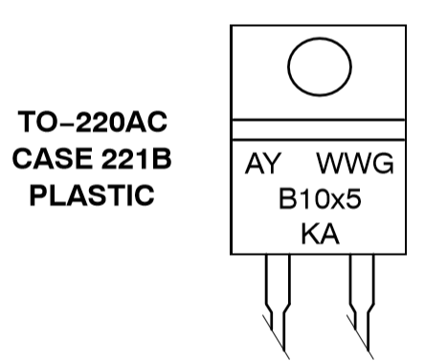
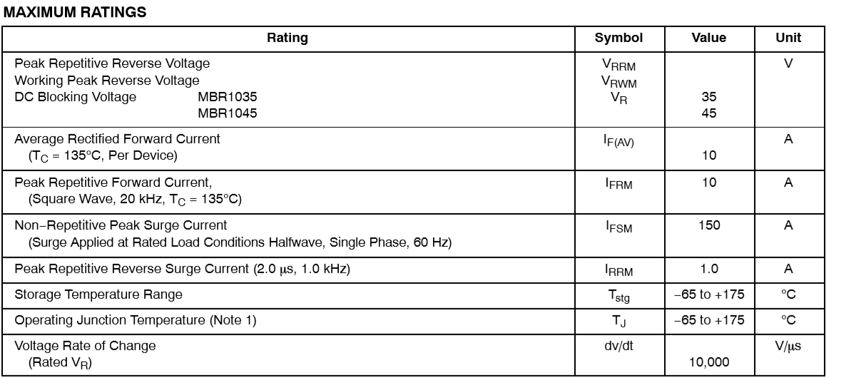
MBR1045 Diodes
SCHOTTKY BARRIER RECTIFIERS 10 A, 35 to 45 V
Features and Benefits
• Low Forward Voltage
• Low Power Loss/High Efficiency
• High Surge Capacity
• 175°C Operating Junction Temperature
• 10 A Total

Slide 4
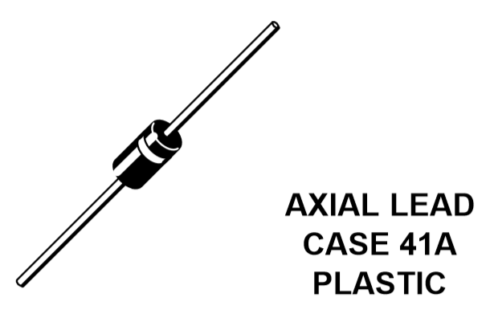
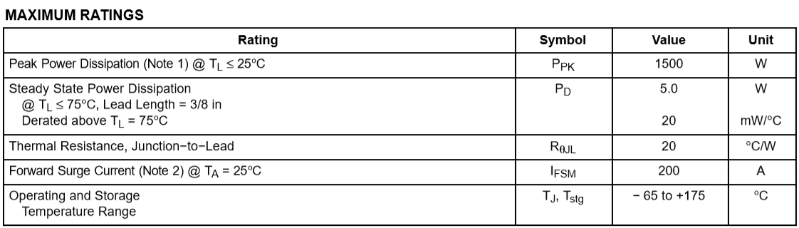
Zener diode
Features
• Working Peak Reverse Voltage Range − 5.8 V to 214 V
• Peak Power − 1500 Watts @ 1 ms
• ESD Rating of Class 3 (>16 kV) per Human Body Model
• Maximum Clamp Voltage @ Peak Pulse Current
• Low Leakage < 5 A Above 10 V
• UL 497B for Isolated Loop Circuit Protection
• Response Time is Typically < 1 ns
• Pb−Free Packages are Available

Slide 5
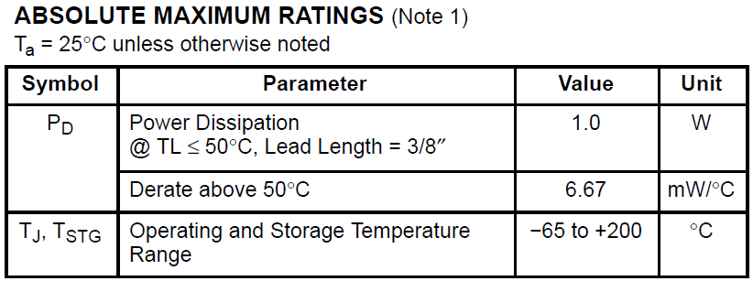
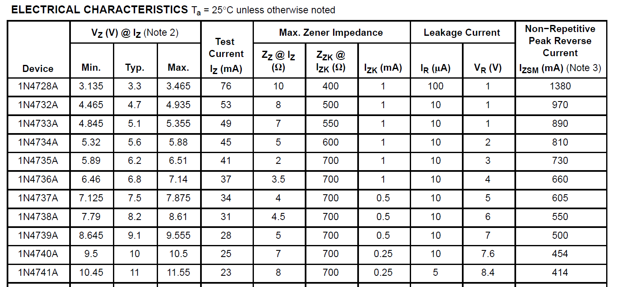
Zener diode (1N4741A) for overvoltage protection circuit

Slide 6
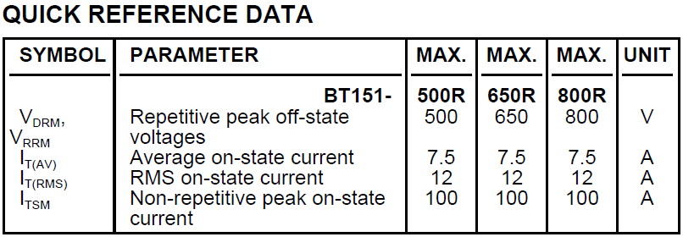
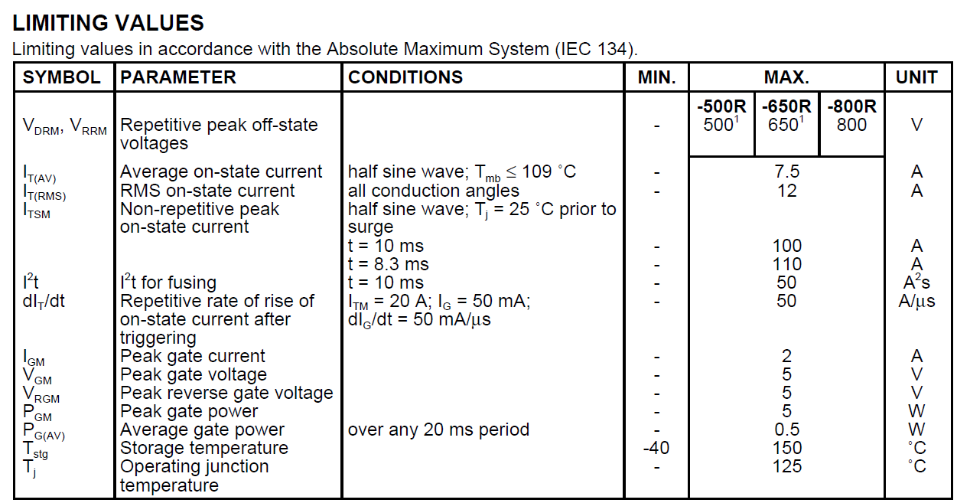
Thyristor (BT151) for overvoltage protection circuit

Slide 7
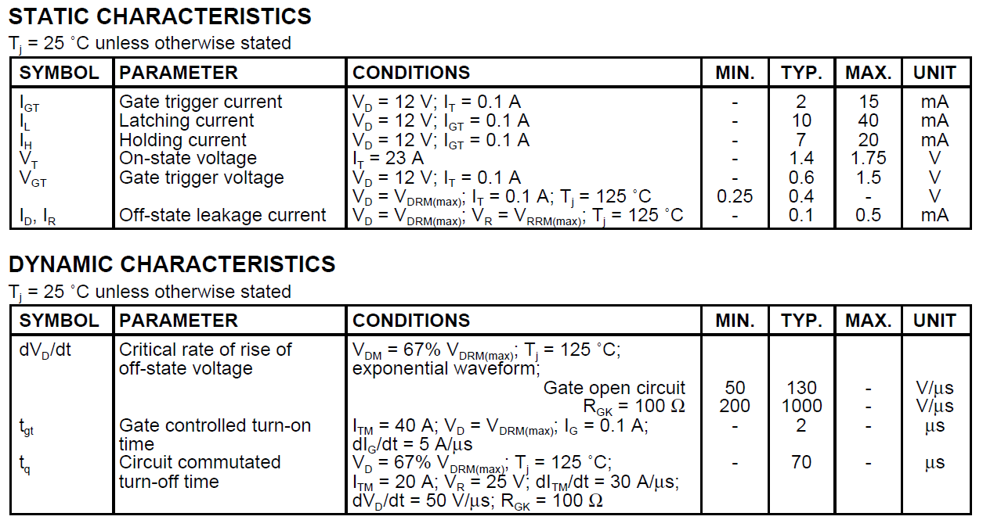

Slide 8
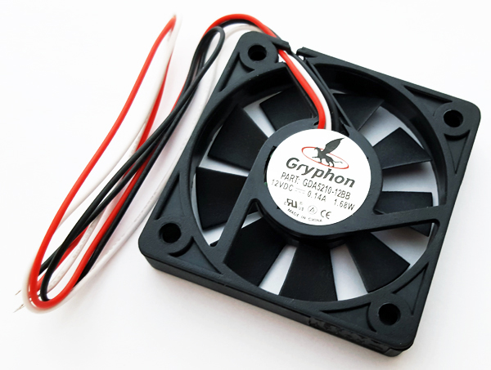
DC FAN
Voltage Rating - 12V Current Rating - 0.14A Max Operating Temperature - 70 °C Max Power Dissipation - 1.7W Height - 52mm Width -10mm

